Slide 1

Introduction to Software Business Product management
Week 2 Day 1
Led by: Emily Crose
for
Oakland University

Slide 2

Week 1 recap

Slide 3

Questions From Last Week?

Slide 4

Securing & Encrypting data

Slide 5

Cleartext vs. ciphertext

Slide 6

Hashing
Notes:
Last week, we talked about “hashing” Does anyone remember the context of what we discussed hashing in?
We talked about hashing in the context of CRCs on information sent over a network.

Slide 7
Value of hashing
Layer of validation of data
Secures both ends of transmission
Anyone can validate!
Protects original secret
irreversible

Slide 8
Popular Hashing algorithms
MD5
SHA-1 (compromised)
SHA-2
SHA-3
LM/NTLM hash (for Windows passwords)
Notes:
9ece086e9bac491fac5c1d1046ca11d737b92a2b2ebd93f005d7b710110c0a678288166e7fbe796883a4f2e9b3ca9f484f521d0ce464345cc1aec96779149c14

Slide 9

Let’s try some hash!
https://gchq.github.io/CyberChef/

Slide 10

What is encryption?

Slide 11
Encryption history

Slide 12

Hand ciphers
Substitution (or “Caesar”) cipher – (850 CE)
Jefferson cipher – (1795)
Vigenère cipher – (1553)
First to use an encryption key
Code book cipher – (1500s?)
Playfair cipher – (1854)

Slide 13
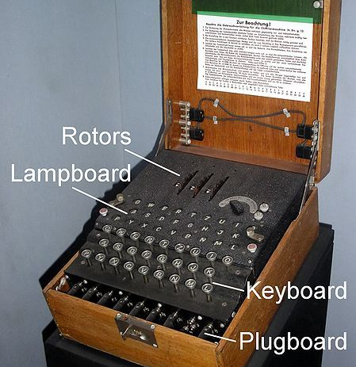
Wartime cryptography

Slide 14
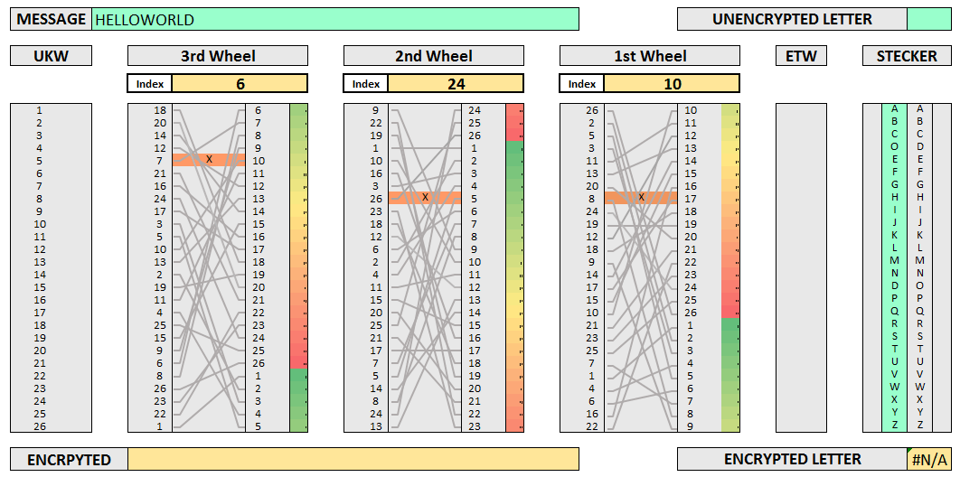

Slide 15

10 minute break

Slide 16
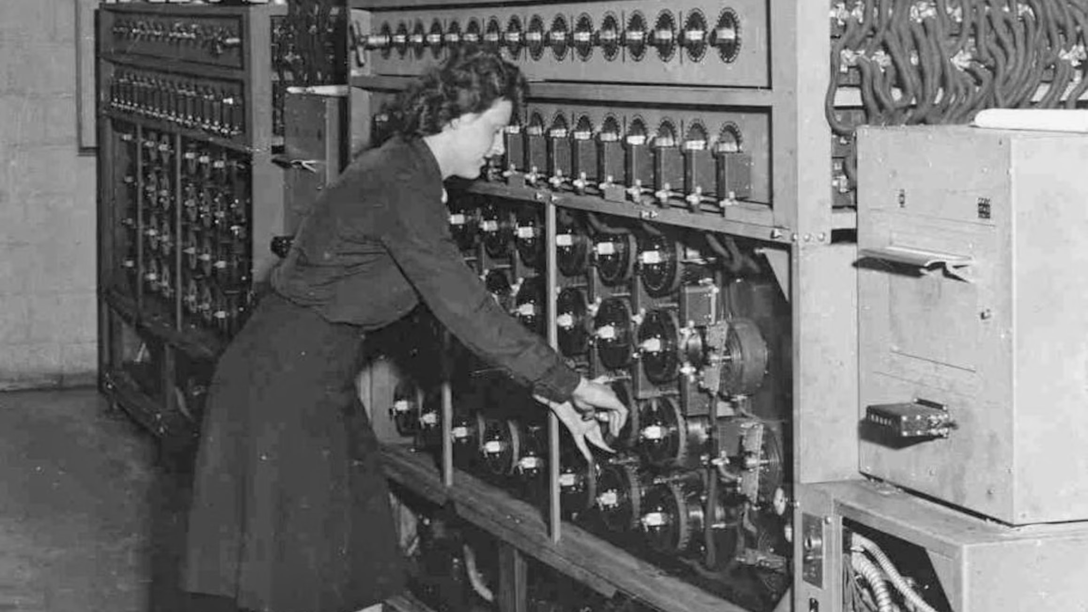
Password cracking
Notes:
Password reuse. Implementation failure. Brute force attacks.

Slide 17
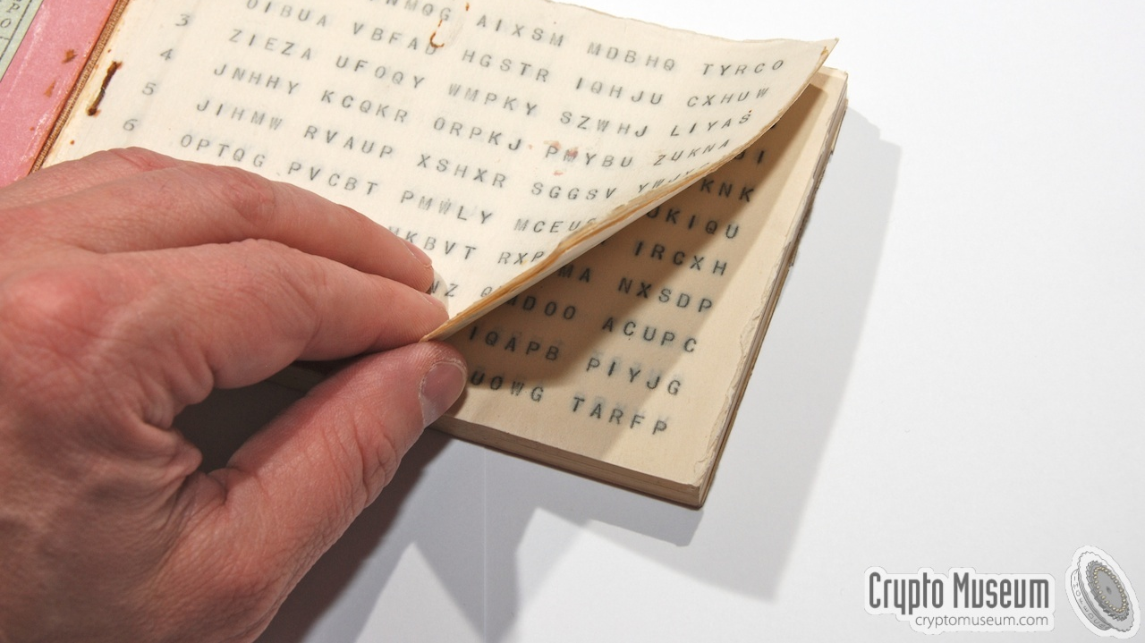
One-time pads

Slide 18

Venona Project
Notes:
Message interception and password cracking

Slide 19

Why do we encrypt?

Slide 20

What do we encrypt?

Slide 21
How do we encrypt today?

Slide 22
Popular cryptography algorithms
Rivest-Shamir-Adleman (RSA) – (1977)
Based on prime number factorization
Advanced Encryption Standard (AES) 256
Block cipher

Slide 23
Keyspace/keylength/keysize
AES
Supports key sizes of 128, 192, 256
Keysizes improve the strength of cryptographic protection
2048 & 4096 keysizes
Large keys
Hard to brute force

Slide 24
Cryptographic standards
https://csrc.nist.gov/Projects/cryptographic-standards-and-guidelines

Slide 25
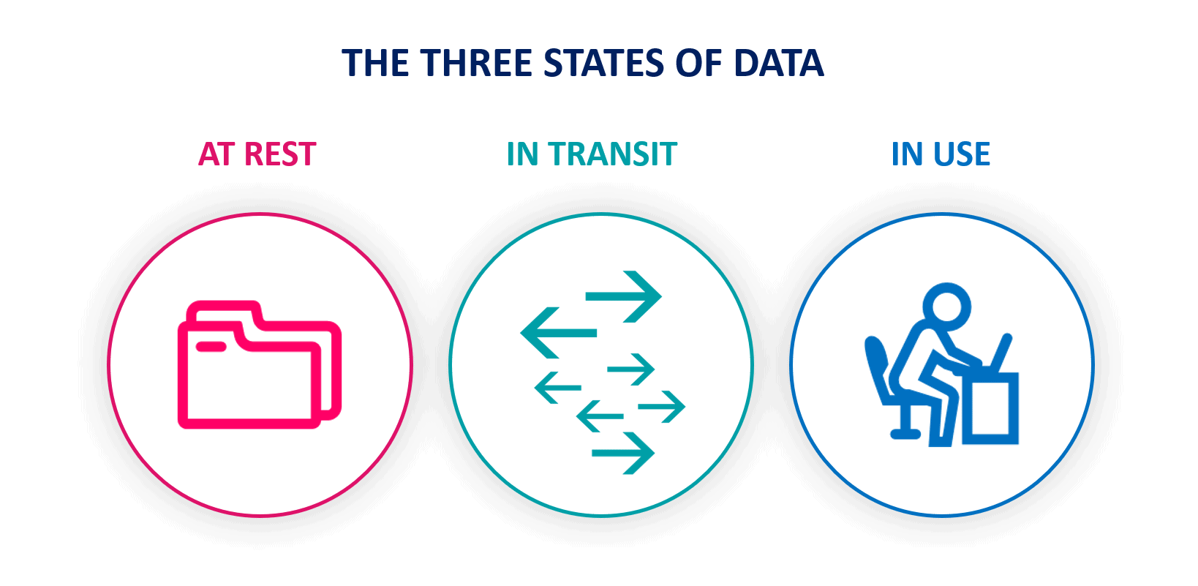
States Of Data

Slide 26
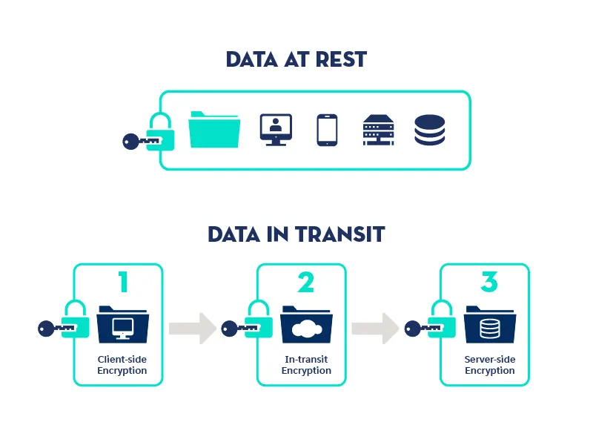
data security

Slide 27
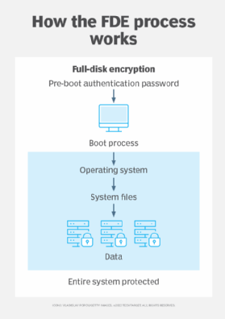
Full disk encryption

Slide 28

Symmetric Key Encryption

Slide 29
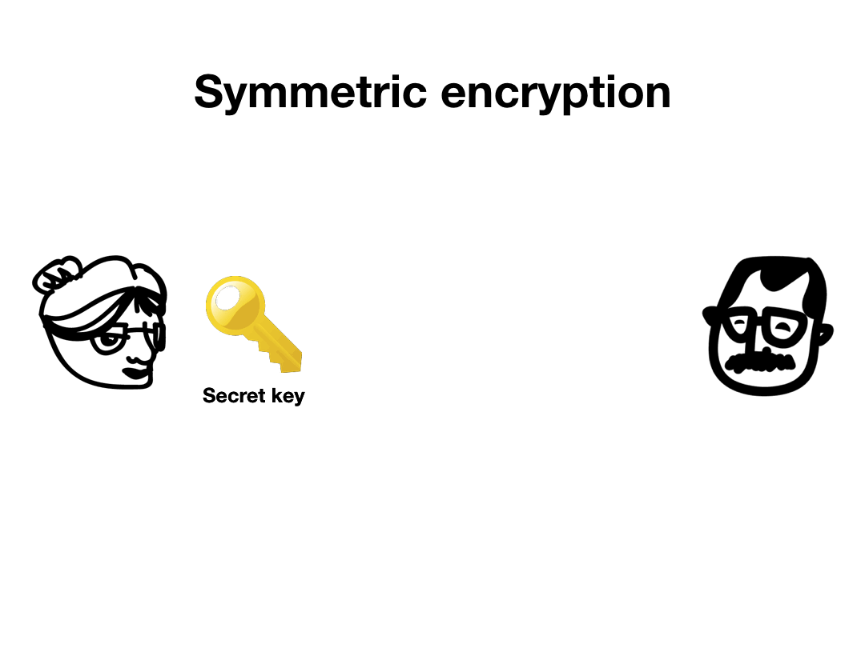

Slide 30

Asymmetric key encryption

Slide 31
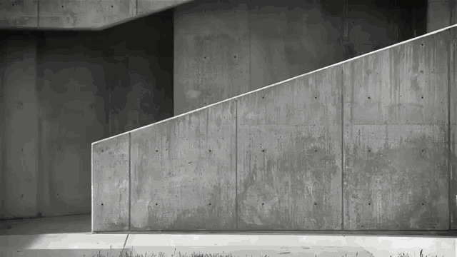
Secure Key Exchange?

Slide 32
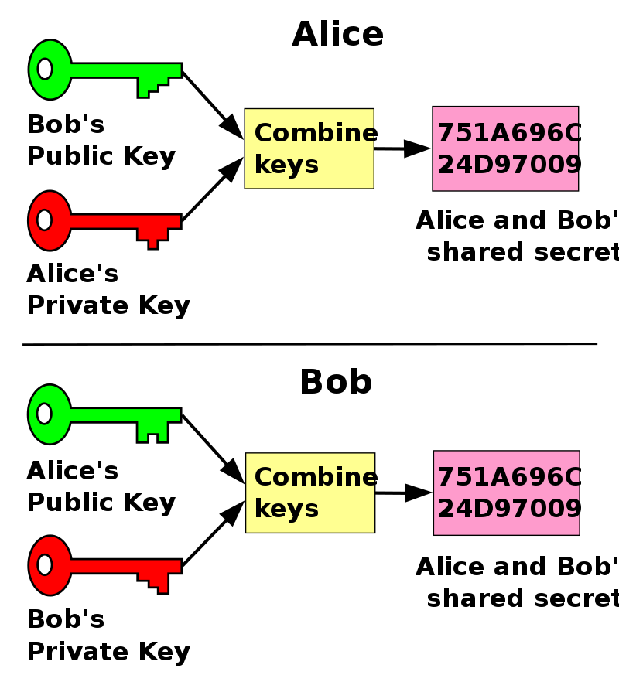
Public key cryptography
Notes:
This is an example of a Diffie-Hellman-Merkle key exchange

Slide 33
10 minute break

Slide 34
Securing network connections in practice

Slide 35
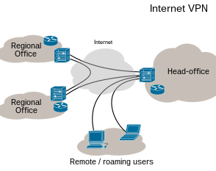
Virtual private networks

Slide 36
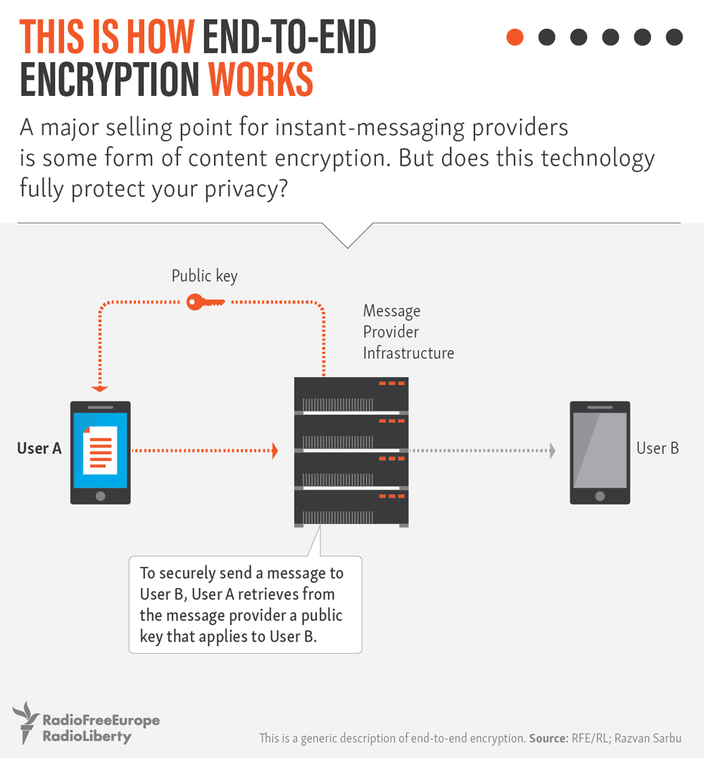

Slide 37
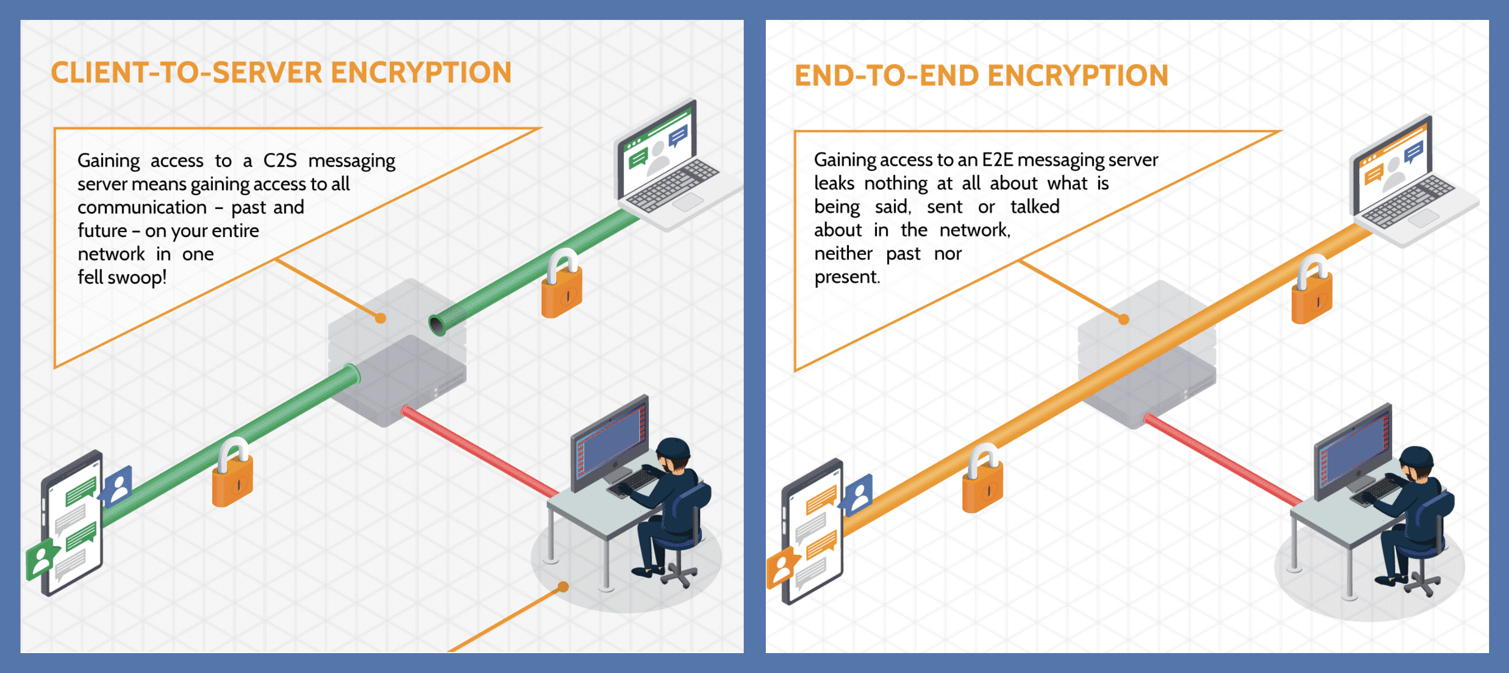
Notes:
The alternative to end-to-end encryption is client-to-server encryption.

Slide 38

Why do we care about trust?

Slide 39
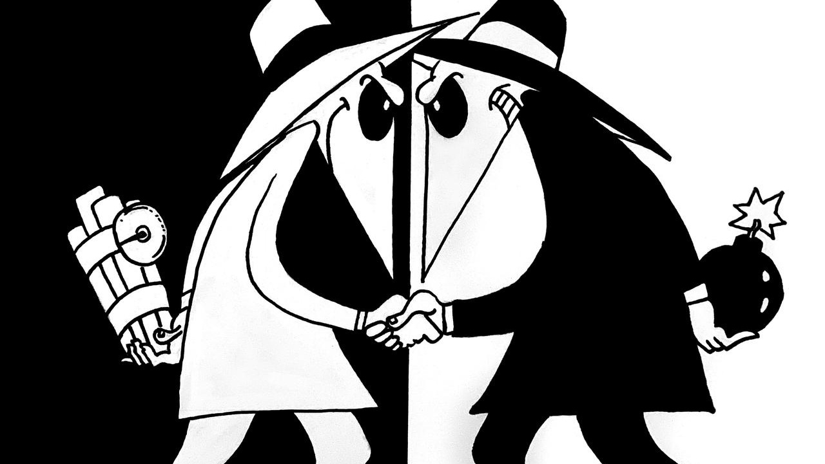

Slide 40
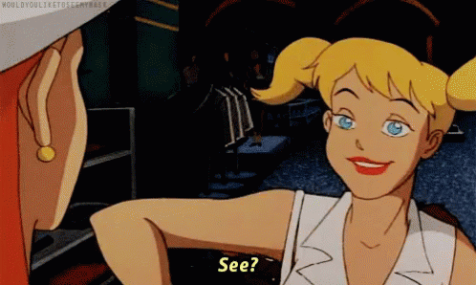
What is a security certificate?

Slide 41
What does a security certificate do?
Provides trust
Allows a secure connection
Encrypts data
HTTPS

Slide 42
Certificate authorities
X.509 certificate
Provides Transport Layer security
Free!
Trusted?

Slide 43

Audit your favorite website!
https://www.sslshopper.com/ssl-checker.html

Slide 44

Threats to poor encryption
Cleartext passwords
Password cracking
Man-In-The-Middle (MITM) attack
Rainbow Tables
Hash collisions

Slide 45
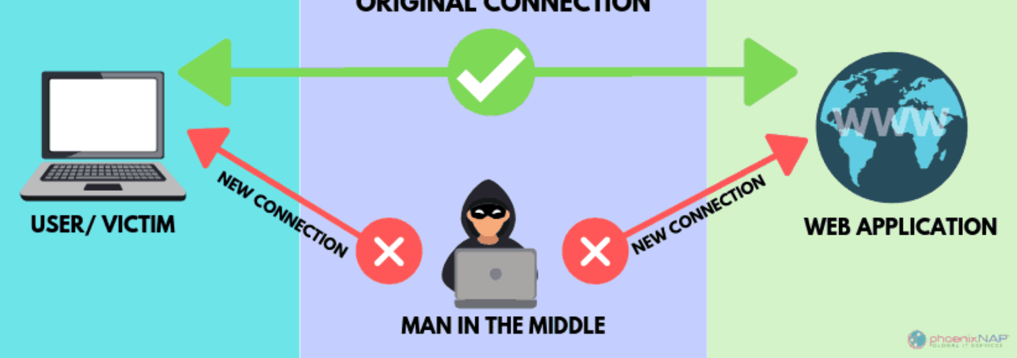
Man-In-The-Middle
Notes:
MITM, password sniffing, collecting cleartext information

Slide 46
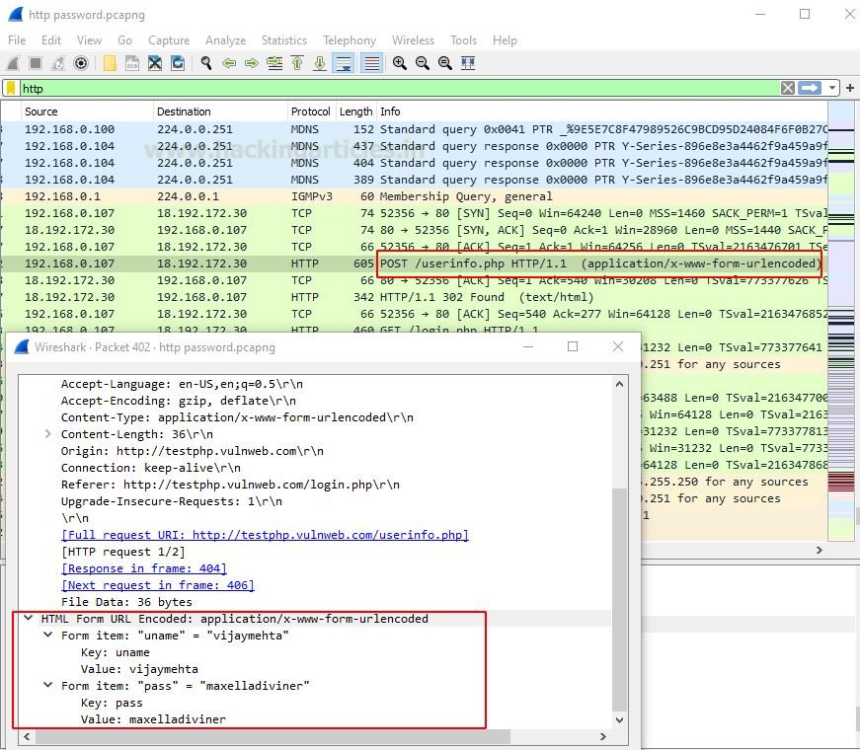

Slide 47
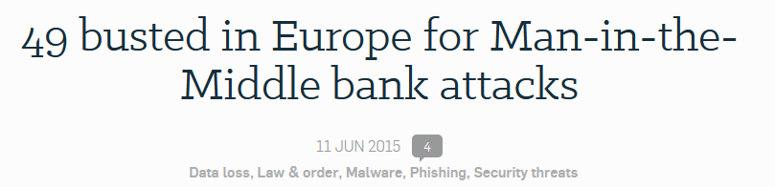
Real-World MITM attack
Notes:
49 attackers were arrested for collecting improperly protected network traffic after a breach on multiple companies. They were looking for financial transaction information, which they found and then used to steal 6 Million Euros or $6.8 Million.

Slide 48

Questions?

Slide 49

Review Day 1

Slide 50

Preview day 2

